Slide 1
Advanced Data Analysis I Course Introduction
PA 541 Week 1
Michael D. Siciliano
Department of Public Administration
College of Urban Planning and Public Affairs

Slide 2

Why are we here?

Slide 3
Answer policy relevant questions
Does going to college increase one’s earnings?
Does providing health insurance to people make them healthier?
Does attending a charter school as opposed to a public school improve student performance?
Does attending various police-community events influence an individual’s perception of or trust in the police?

Slide 4

Causality
http://www.causality.inf.ethz.ch/cause-effect.php

Slide 5

What is wrong with the following claim: Data show that individual income and marriage have a high positive correlation. Therefore, your earnings will increase if you get married (from Pearl et al. 2016).

Slide 6
Two major challenges to causality
Randomness – is what we observe really just a coincidence?
Endogeneity – is the relationship we observe really just due to another variable?

Slide 7
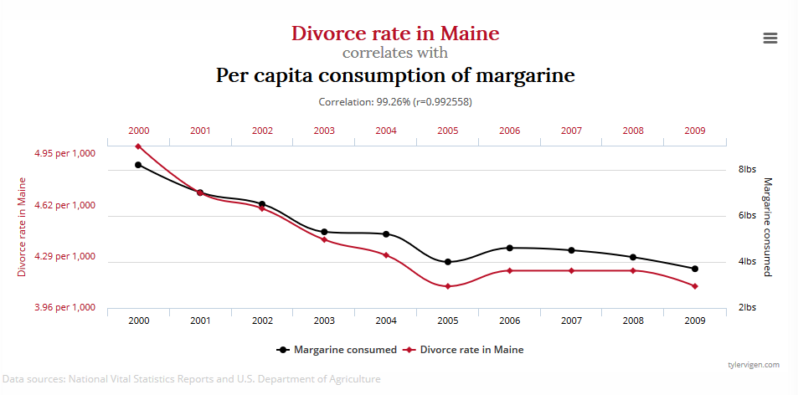
An example of randomness

Slide 8

An example of endogeneity
Ice cream sales predict homicide rate.

Slide 9
Course overview
My main goal is to develop your skills and abilities to conduct empirical research using linear models in hopes of producing accurate inferences.
The main focus will be on your ability to appropriately develop and interpret statistical models based on a strong conceptual understanding of modeling assumptions and limitations.
Topics to be covered in this course include standard OLS regression, regression with qualitative predictors, model specification, data issues, limited dependent variable models, panel data methods, and data visualization.

Slide 10
Regression
Two purposes of regression:
Prediction
Focus is on predicting the outcome value
Explanation
Focus is on identifying the effect of predictor variables on the outcome
When might we prefer one to the other?

Slide 11
What is econometrics
Econometrics is the application of statistics and theory in order to test hypotheses.
Theory will be used to help describe the relationship between the variables under study.
Theory provides a lens for our world; it helps us determine what we should be looking at; what variables we should measure.
For example, the law of supply and demand tells us that there is a negative relationship between price and quantity demanded.
If you work for a city or state considering an increase in cigarette taxes (as Chicago has done in the past) you would want to know the magnitude of the relationship between price and quantity. In other words, by how much would demand fall if we increased price by $2.
To answer these questions, we can investigate the empirical relationship between cigarette prices and cigarette purchases.

Slide 12
Probability and Statistics
In probability the parameters are known and they control the behavior of a random variable via a model.
We use the known odds or probabilities to estimate the likelihood of certain future events occurring.
In statistics (probability in reverse) the random variables (or the data) are known, and they are used to estimate the unknown parameters that gave rise to them via a model.

Slide 13
Here is an example
Model: suppose we play 100 independent win-or-lose games, each with a probability of X.
Then X is a parameter, and the number of wins is a statistic.
In probability:
We fix X = 244/495 (i.e. the odds you win in a game of craps); go to the casino and see how you fair.
In statistics:
I just got back from the casino and I won 51/100 games. What can I say about the value of X?
This approach is what we do in empirical research. We collect some data and try to find the processes that generated it.

Slide 14
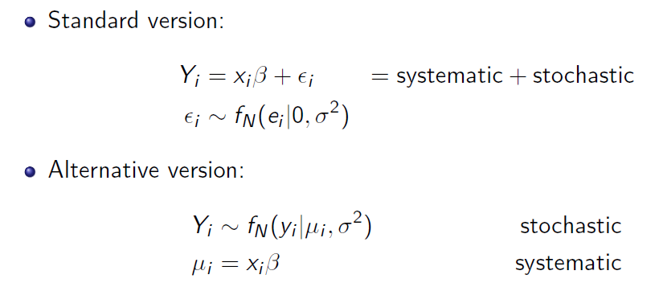
What are statistical models?
A statistical model is a formal representation of the process by which a social system produces output.
Equivalent notation (King 1998)

Slide 15
Specifying statistical models
Model specification has to deal with two components of our statistical model:
The functional form that relates measured variables to measured outcomes.
In other words, our belief in the relationship between the independent variables and the dependent variable.
Our goal is to identify the unknown model parameters.
One thing to keep in mind is that data do not produce a model…rather data reduce our uncertainty about the unknown model parameters.
Assumptions about the disturbances (i.e. the unmeasured variables influencing the observed outcomes – the error term).

Slide 16
Model example
Economic model of crime (Becker (1968))
Derives equation for criminal activity based on utility maximization
Functional form of relationship not specified
Should age have squared term? Should Criminal wages be interacted with probability of being caught?
Age
„Wage“ of cri-
minal activities
Wage for legal
employment
Probability of
conviction if
caught
Expected
sentence
Other
income
Probability of
getting caught

Slide 17
Econometric model of criminal activity
The functional form has to be specified
Variables may have to be approximated by other quantities (some theoretically relevant variables we cannot obseve)
Measure of criminal activity
Wage for legal
employment
Other
income
Frequency of
prior arrests
Unobserved deter-
minants of criminal
activity
e.g. moral character,
wage in criminal activity,
family background …
Frequency of
conviction
Average sentence
length after conviction
Age

Slide 18
Models vs Estimation Procedures (Hayashi 2000)
A model is a formal representation of the process by which a social system produces output.
An estimation procedure is a data-based protocol for choosing from the model the parameters most likely to have generated our data.
For most of this class, we will be working with a linear regression model and using OLS as our estimation procedure.
For instance, you collect data on home ownership rates in different cities along with a range of predictor variables. You can estimate a linear regression via OLS to understand the size and significance of the predictor variables relationship with home ownership.
When we move to logistic regression, we utilize a different probability distribution, and a new estimation procedure – maximum likelihood.

Slide 19
Class Content and Overview

Slide 20
Texts
Wooldridge, J. M. (2016). Introductory econometrics: a modern approach: Cengage Learning. [Required: Earlier editions are fine]
Long, J.D. & Teetor, Paul (2019). R cookbook: O'Reilly [Optional]

Slide 21
Weekly readings and class structure
The goal of this course is to provide you with the fundamental tools needed to analyze relationships and investigate phenomena of interest to you.
Each week we will:
explore different aspects of linear models,
witness the use of those models in scholarly articles, and
implement those models in R
I will post my lecture slides before each class. All slides, readings, data sets, and R codes will be available in the ‘Weekly Lectures and Readings’ tab on blackboard.

Slide 22
Homework
Problem sets will be due several times throughout the semester. I expect to assign 4 sets.
I encourage you to work with your classmates on these assignments, but ultimately complete and write-up the answers by yourself.

Slide 23
Data Analysis Paper
We will be putting our econometric skills into action through a data analysis paper (approximately 3,000 to 5,000 words).
You will work in groups of 3 or 4 on this paper.
You will not need to collect original data. You will rely on existing data sources.
There are many online datasets and repositories such as such as ICPSR, World Values Survey, IES, Census Data, Pew Internet and American Life Project, Current Population Survey, FedView survey, Harvard Dataverse, open data portals, etc...
Alternatively, you can respectfully ask a faculty member at this or another institution if they would be willing to share their data.

Slide 24
Data analysis paper cont…
You will be required to develop testable hypotheses using methods covered in this course and to situate your hypotheses within the current literature or policy debate regarding your topic of interest.
The aim of this paper is to give you a more complete experience of the data analysis process. You will go from initial data screening and cleaning to final model output and interpretation.
For this assignment you will write your paper as if preparing it for submission to a journal or as a report to a relevant agency, nonprofit or think tank.
Please find a dataset early on in the semester. You can then use this data set to work through the methods we are covering in class. Having data that is meaningful to you is one way to overcome a general distaste for anything quantitative.

Slide 25
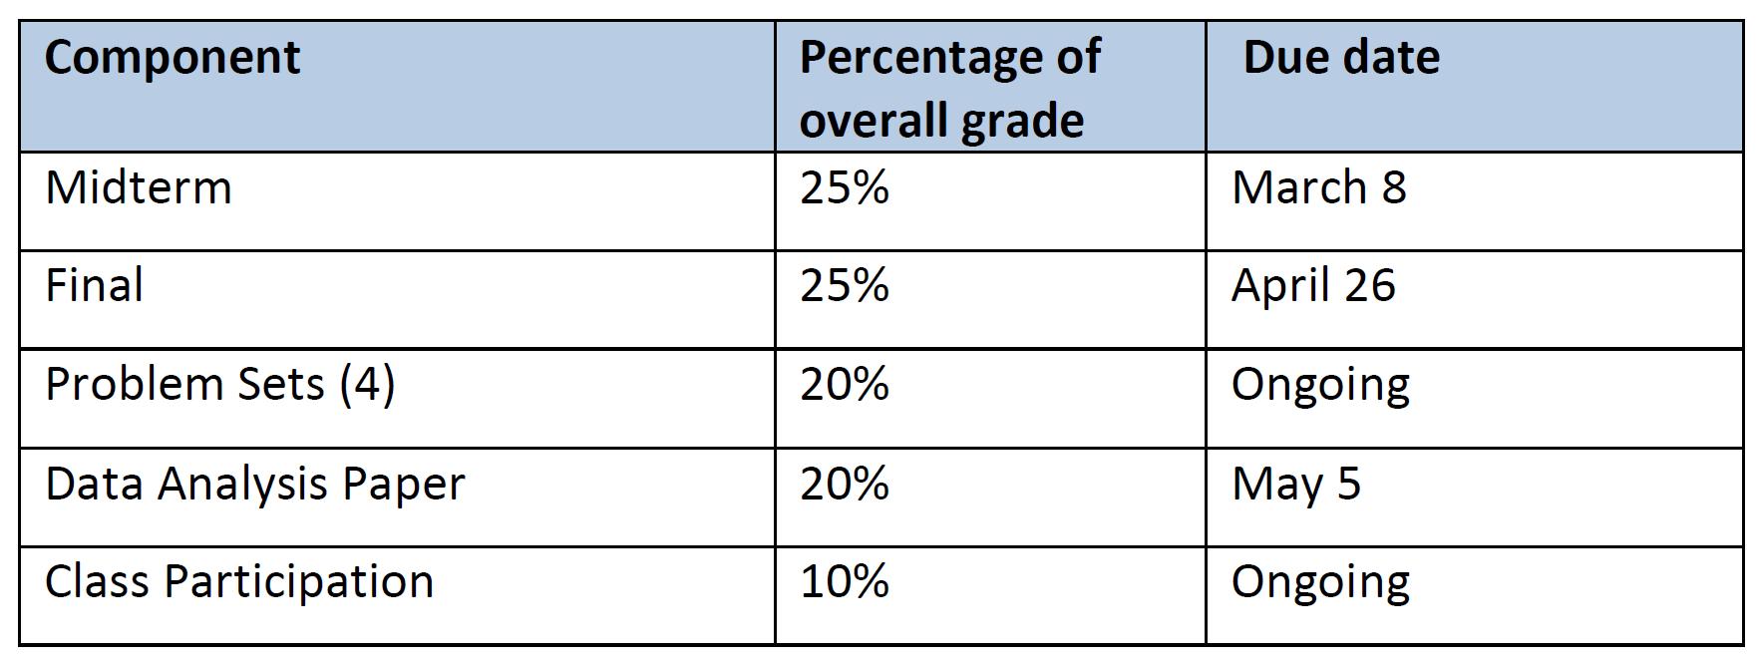
Grading
Updated Midterm Date as of 1/10
Your grade in this course will be calculated as follows:

Slide 26
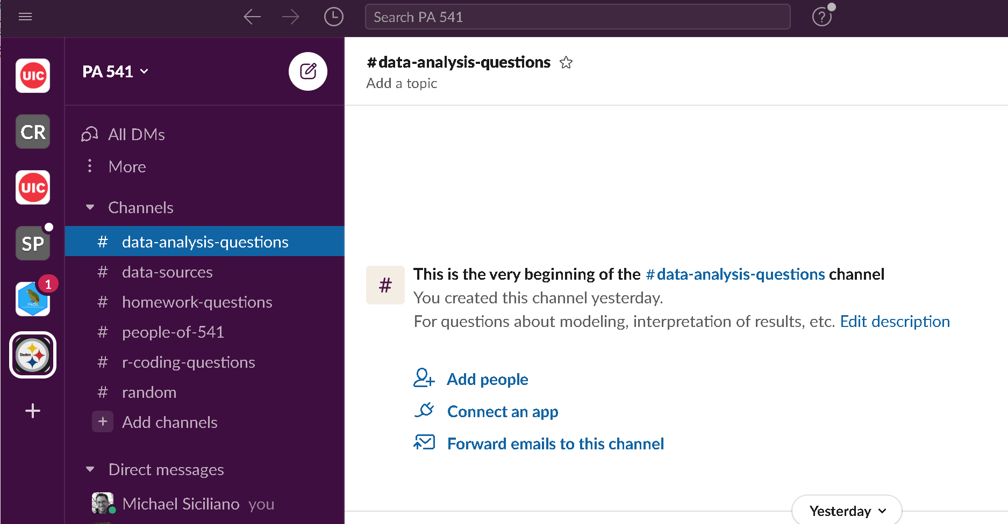

Q&A and Communication Through Slack

Slide 27

Why We will be using R
Unrivalled coverage and availability of new, cutting-edge applications in the field (no need to wait for a new release of the software).
Facilitate your understanding of the literature as more and more people are reporting their results in R.
Quality of support available through listservs, Stack Exchange, etc…
Ease with which you can write your own functions.
The product is free!
I have put some material in an R Resources folder on Blackboard.

Slide 28
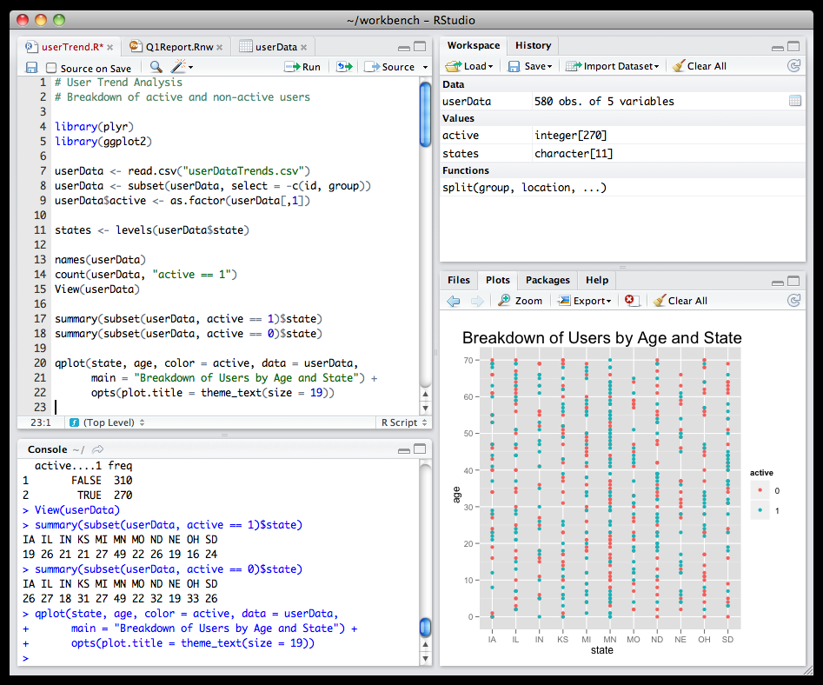
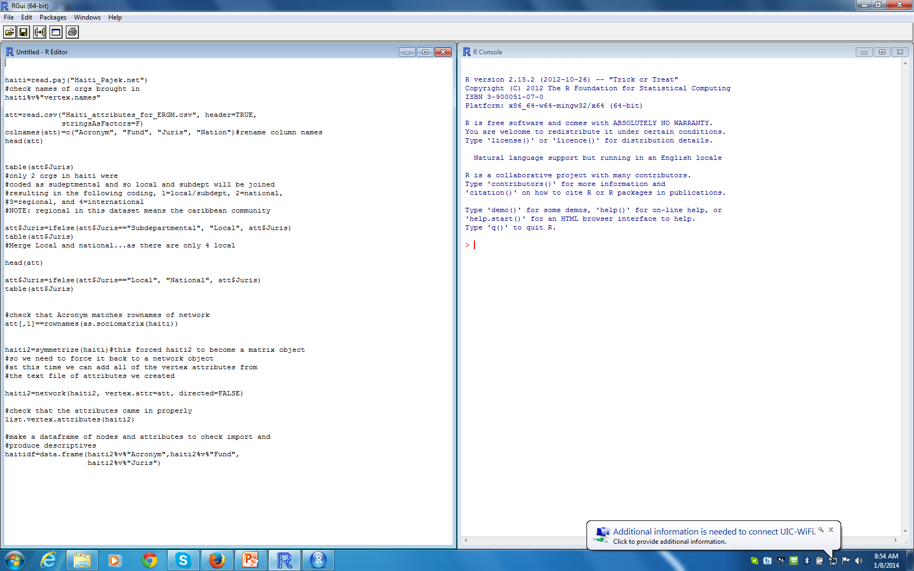
R Studio
R Studio is an integrated development environment (IDE) for R.

Slide 29
Using Scripts
Why use scripts?
Allows others to view and reproduce your work.
Allows you to go back to your work months later and see exactly what you did.
Facilitates small changes in your procedures without having to redo all of your other work.
I will provide you with my scripts for each class.

Slide 30
Optional Labs?
Several times through the semester I or the TAs may hold optional labs to help students with homework, learning R, covering material in more detail, etc…
These are completely optional, but have been really helpful to students in the past.
I often hold them prior to the homework being due so you can ask questions about things you may be unsure about.

Slide 31
Questions on class structure, software, expectations, etc?

Slide 32
Intro to R and review of basic concepts

Slide 33
The R programming language
R is a system for statistical computation and graphics.
R uses object-oriented programming.
When you run a regression in SAS or SPSS the program dumps a bunch of output onto your screen.
In R, when you call the lm() regression function it returns an object containing all of the results. You can then pick and choose which aspects of the object you wan to extract (coefficients, standard errors, residuals, etc…).
This becomes extremely helpful as your data and analysis becomes more complex.
Ex. Analyzing data from several different sites and then wishing to compare the modeling results.

Slide 34
Modes of objects in R
Modes are the data type of an object.
Most basic modes for objects are:
Numeric
Logical
Character

Slide 35
Main object ‘classes’ in R
The entities that R operates on are known as objects.
Objects we will most commonly use are:
Vectors – Most basic data object in R. All elements of a vector must be of the same mode.
Matrices – Corresponds to the mathematical concept of the same name.
Arrays - Arrays are similar to matrices but can have more than two dimensions.
Data frames - A data frame is more general than a matrix, in that different columns can have different modes (numeric, character, factor, etc.). This is similar to SAS and SPSS datasets.
Lists - An ordered collection of objects (components). A list allows you to gather a variety of (possibly unrelated) objects under one name.
Factors - variables in R which take on a limited number of different values, i.e., categorical variables.

Slide 36
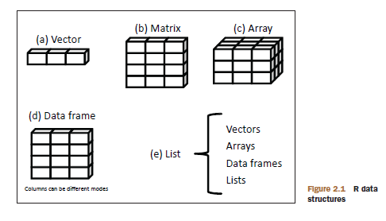
Image from Kabacoff’s R in Action (2011, p. 23)

Slide 37

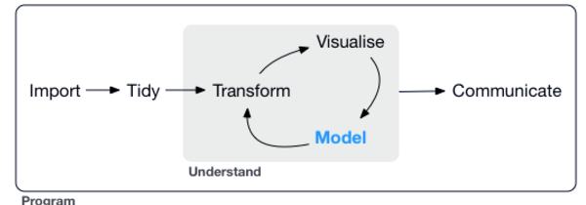
Tidyverse

Slide 38
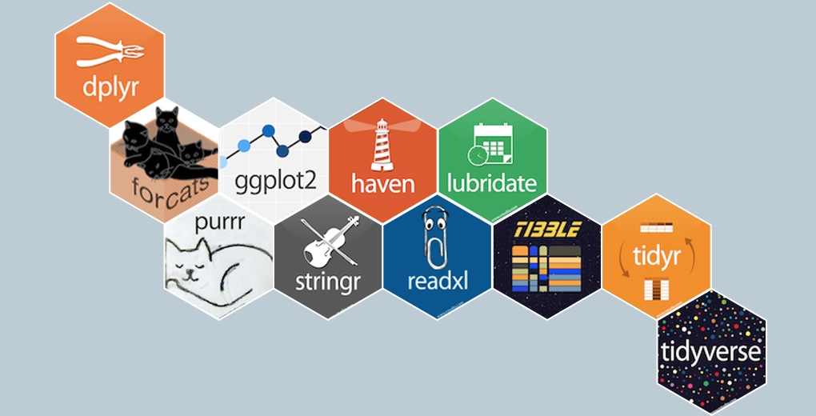

Slide 39
Switch to R Studio.
The script I walk us through is posted on Blackboard and contains some sections for you to create code.
To begin:
Save the R script on Blackboard into a local folder on your computer. I recommend starting a 541 folder, and then create subfolders for each week.
Open R Studio and then open the R script (file -> open file and then navigate to the appropriate folder.
We will walk through the script together.

Slide 40

In-class practice
See blackboard for script and data.
Will work with the Midwest dataset and practice reading, examining, and wrangling data.

Slide 41
Review of Statistical Concepts
For your own review; will not cover in class.

Slide 42
Sample characteristics
In many instances, we will not know the true expected value or variance of a distribution of interest.
For example, we may want to know about the degree of income inequality in society, and therefore want to know the expected value and variance of income distribution in the population.
If we took a census of all members of the intended population we could find the true values for the characteristics of the distribution.
However, such a process is extremely costly in terms of time and money.

Slide 43
Instead, we often take a sample of the population and use the sample to generate our best guess as to what the true characteristics of the population distribution are.
Much of the data social scientists use come from sample surveys.
A random sample is n observations that are drawn independently from the same population.
Suppose we are interested in understanding the recidivism rate among inmates in the United States.
We would probably want to know the average rate and how much variation there is around that average.

Slide 44
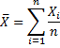
Sample mean
Let’s say we go out and collect the following data on inmate recidivism from 5 randomly chosen inmates: 1, 2, 3, 3, 4
Sample mean = = (1+2+3+3+4)/5 = 2.6
We can think of the sample mean as an estimator of the true population mean, µ_{x.}
Thus, estimators are a “guess” of the true value of a parameter of interest.

Slide 45
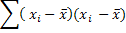
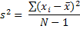
Sum of Squared Errors and Variance
Sum of Squared Errors =
= (-1.6)² + (-0.6)² + (0.4)² + (0.4)² + (1.4)² = 5.20
However, this value is dependent on the number of observations…
Variance =
Variance = 5.20/4 = 1.3
In this example we can now say that the average error in our model is 1.3 squared. It makes little sense to talk about squared recidivism rates and so we often take the square root of the variance which is the standard deviation.

Slide 46
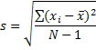
Standard Deviation
Our standard deviation is the square root of 1.3 which is 1.14.
Now our measure of average error is in the same units as the original measure.

Slide 47
Standard Deviation versus Standard Error
When we take a sample, it is only one of many possible samples of our intended population.
It is important to know how well a particular sample represents the overall population. To do so we need to consider the standard error.
The standard error (s.e.) is based on a sampling distribution.
Sampling Distribution – the frequency distribution of sample means from the same population.
Assume we gathered 100 different samples of size 50. Each of these samples will have a slightly different mean.

Slide 48
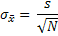
Standard Error
Calculating the standard deviation of our sampling distribution would give us a measure of how much variability there was between the means of the different samples.
The standard deviation of this sampling distribution is the standard error.
In reality, we cannot (or should not) collect hundreds of samples to produce a sampling distribution. Therefore, we must rely on an estimate of the standard deviation of that distribution.
The approximation is calculated as follows

Slide 49
Probability distributions
Discrete distributions – for variables that can take on only a finite number of values.
Many useful discrete distributions for statistics such as the binomial distribution and the Poisson distribution.
We will use these toward the end of the semester.
Example, the number of heads in two coin tosses is a discrete distribution as the only possible values are 0,1, or 2.

Slide 50
Probability distributions
Continuous distributions
The normal distribution is a continuous probability distribution that has the well known bell-shaped curve.
If a random variable X, comes from a normal probability distribution, we write X ~ N(µ_{x},σ_{x}²)
Many real world variables appear to follow a normal distribution, i.e., height.

Slide 51
Let’s produce a probability distribution
Assume we flip two fair coins. What is the sample space of all possible outcomes?
# of Heads | Sample Points | Probability

Slide 52
Let’s produce a probability distribution
Assume we flip two fair coins. What is the sample space of all possible outcomes?
This description of the probabilities for each event is called a Probability Distribution Function (PDF).
The PDF shows the probability that a random variable will take on each outcome in a sample space.
Let’s draw the PDF.
# of Heads | Sample Points | Probability
0 | TT | ¼
1 | HT, TH | ¼ + ¼ = ½
2 | HH | ¼

Slide 53
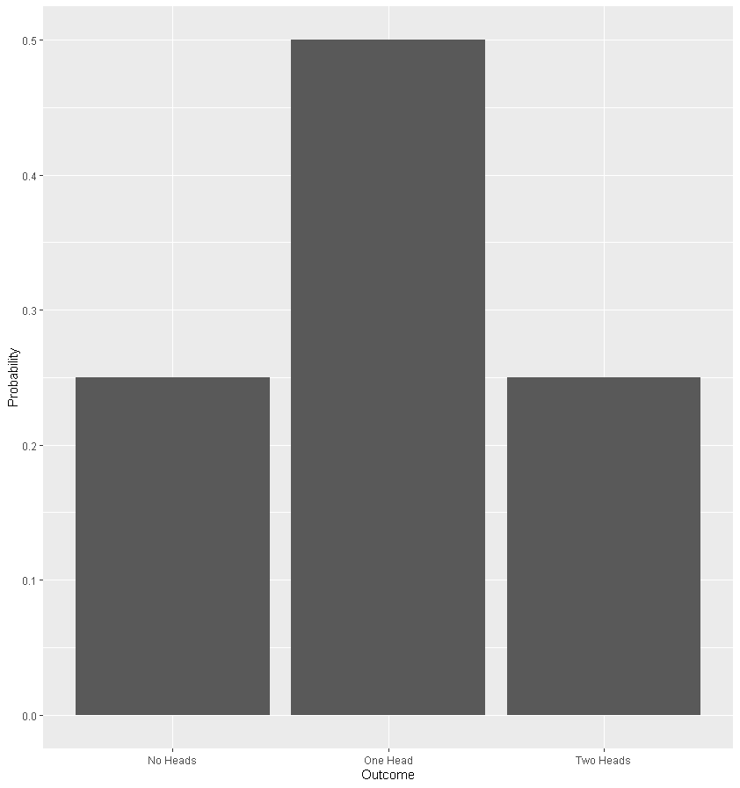

Slide 54
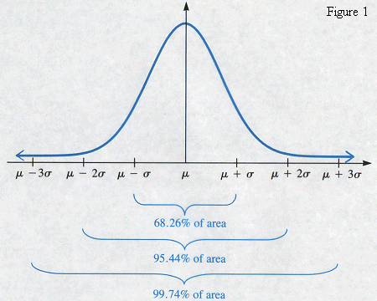
Normal Distribution
What about for continuous variables?

Slide 55
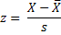
Z-Scores
To covert any normal distribution into a standard normal distribution with a mean of zero and standard deviation of 1, we simply need to:
Center the data at zero by subtracting the mean from all scores
Divide the resulting score by the standard deviation to ensure that the data have a standard deviation of 1.

Slide 56
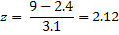
Example of z-score
Assume the recidivism rate of a given population is normally distributed with mean of 2.4 and a standard deviation of 3.1.
Thus, X ~ N(2.4, 3.1)
What is the probability that there is a particular individual who has returned to jail 9 times. Based on the previous equation:
So our z-value is 2.12. We can use any z table to look up this value and find the probability of finding a value greater than this. In other words, what is the likelihood that a randomly sampled individual recidivated 9 times or more.

Slide 57
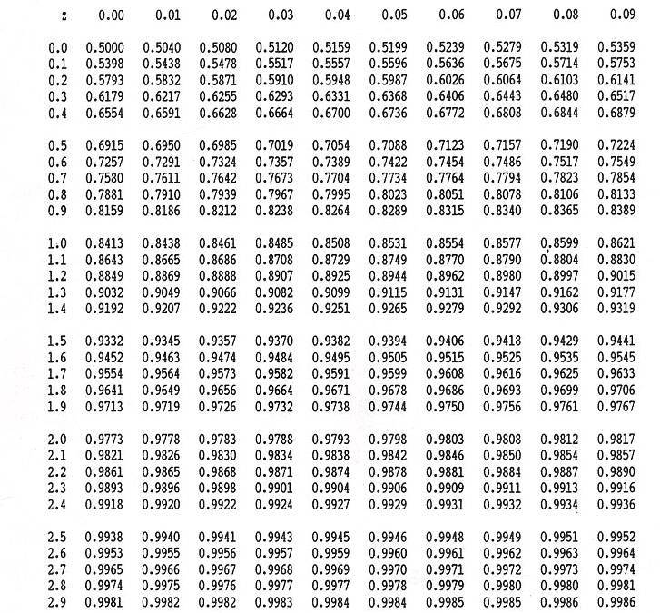
Looking at a table of z-scores (which indicate the area to the left of our z-value), we can see that at 2.12, 98.3 percent of all scores lie to the left of our value. And so there is only a 1.7% change of finding someone who has recidivated 9 times or more.

Slide 58
Central Limit Theorem
Regardless of the distribution of the original variable x from which the statistic was generated, the asymptotic sampling distribution of the statistic will be normal.
Again,
Consider that when we take a random sample of size n, this sample is only one of many possible samples of size n that could be drawn from the population.
Obviously, if we took a second sample of size n, we would not end up with the same respondents and so any statistic calculated (like the mean) would be different from the first sample.
The CLT, however, says that if we were to take all possible random samples of a given size from the population and compute the value of the statistic of interest for each one, the distribution of these statistics – the sampling distribution – would be normal (assuming the sample size is large enough).
The standard deviation of this sampling distribution is our standard error.

Slide 59
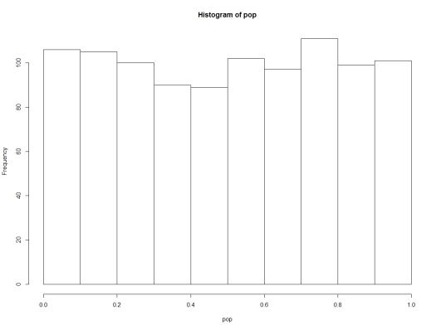
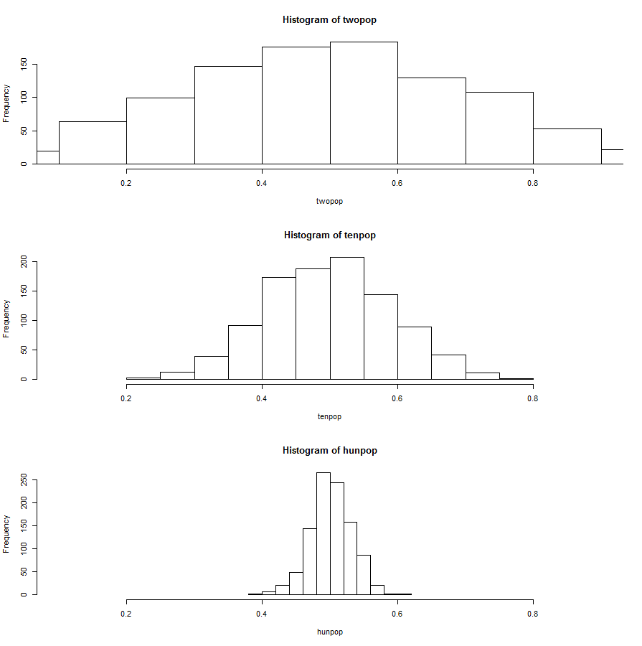
Demonstrating the CLT
pop=runif(1000, 0,1)
hist(pop)
twopop=vector()
for (i in 1:1000) twopop[i]= mean(runif(2, 0,1))
tenpop=vector()
for (i in 1:1000) tenpop[i]= mean(runif(10, 0,1))
hunpop=vector()
for (i in 1:1000) hunpop[i]= mean(runif(100, 0,1))
par(mfrow=c(3,1))
hist(twopop, xlim=range(.1,.9))
hist(tenpop, xlim=range(.1,.9))
hist(hunpop, xlim=range(.1,.9))

Slide 60
From 1 variable to 2

Slide 61
Covariance and Correlation
A correlation is a measure of a linear relationship between two variables.
Two measures are particularly important for statistically expressing the relationship between two variables:
Covariance
Correlation Coefficient

Slide 62
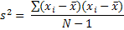
Covariance
Recall our formula for variance:
Which is the equivalent of:
Covariance is a measure of the average relationship between two variables. It is the average cross-product deviation.

Slide 63
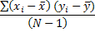
Covariance Cont…
Covariance = cov(x,y) =
When we multiply the differences in one variable by the corresponding differences in the other we produce what is known as the cross-product deviations. We then divide this value by N-1 to produce the average sum of differences, known as the covariance.

Slide 64
Example of Covariance
Country | 1 | 2 | 3 | 4 | 5 | Mean | s
GNP | 5 | 4 | 4 | 6 | 8 | 5.4 | 1.67
Crime | 8 | 9 | 10 | 13 | 15 | 11.0 | 2.92
cov(x,y) =
= [(-0.4)(-3)+ (-1.4)(-2) + (-1.4)(-1) + (-0.6)(2) + (2.6)(4)] / 4 = 17/4 = 4.25
A positive covariance indicates that when one variable deviates from the mean the other variable does so in the same direction.
One Problem: Covariance is dependent on the unit of measurement and does not allow for objective comparison across datasets.
For instance, if I multiple GNP by 10, then the covariance would also increase by a factor of 10.

Slide 65
Standardizing the Covariance
To overcome the issue of dependence on measurement scale we often convert the covariance into a standard set of units.
In the same manner as calculating z-scores, we standardize covariances by dividing by the standard deviation.
We have actually have two standard deviations (because we have two variables whose relationship we are interested in).

Slide 66
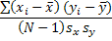
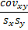
Pearson Correlation Coefficient
The standardized covariance is known as a correlation coefficient.
Pearson Correlation Coefficient:
= = r
By standardizing the covariance we force our value to be between -1 and +1. A measure of ± 1 indicates perfect correlation between two variables.

Slide 67
Correlation as a measure of effect size
Correlation coefficient can be uses as a standard measure of effect size
± .1 is a small effect
± .3 is a medium effect
± .5 is a large effect

Slide 68
Type I and Type II Errors
The American Court System is designed to limit Type I errors; the burden of proof rests with the plaintiff and thus the null hypothesis is that one is innocent until proven guilty.
Type I error (false positive) – we reject the null when in fact it was true. We reject the null of innocence and find someone guilty when in reality they committed no crime. So we place an innocent man in jail.
Type II error (false negative) – we accept the null when it should have been rejected. We find someone innocent when in reality they were guilty of the crime.

Slide 69
In more statistical terms:
Type I Error: we find a significant relationship between two variables or a difference between two means when in reality there is no relationship or difference.
Type II Error: We find no relationship between two variables or no difference between two means when in reality there was a relationship or difference.

Slide 70
Confidence Intervals

Slide 71
Estimation
There are two general methods of communicating results of an analysis:
Point estimation: guess a single value for the true value (e.g., we use the sample mean to estimate the true population mean).
Interval estimation: use a sampling distribution to guess an interval for the true value.
As we discussed earlier, a sample mean is usually not equal to the population mean; generally there is some sampling error.
Thus, we often want to accompany any point estimate with information that indicates the accuracy of that estimate.
These intervals are known as confidence intervals.

Slide 72
Confidence Level, (1-α)
Suppose confidence level = 95%
Also written (1 - α) = 0.95
A relative frequency interpretation:
From repeated samples, 95% of all the confidence intervals that can be constructed will contain the unknown true parameter.
Any specific interval either will contain or will not contain the true parameter
No probability involved in a specific interval

Slide 73
Sampling Distribution of the Mean
x
Intervals extend from
to
x₁
x₂
100(1-α)% of intervals constructed contain μ;
100(α)% do not.
Confidence Intervals
Following slides adapted from: Statistics for Business and Economics, 6e © 2007 Pearson Education, Inc.

Slide 74
General Formula
The general formula for all confidence intervals is:
The value of the reliability factor depends on the desired level of confidence
Point Estimate ± (Reliability Factor)(Standard Error)

Slide 75
Finding the Reliability Factor, z_{α/2}
Consider a 95% confidence interval:
Z units:
z = -1.96
0
z = 1.96
X units:
Lower
Confidence
Limit
Upper
Confidence
Limit
Point Estimate
Point Estimate

Slide 76
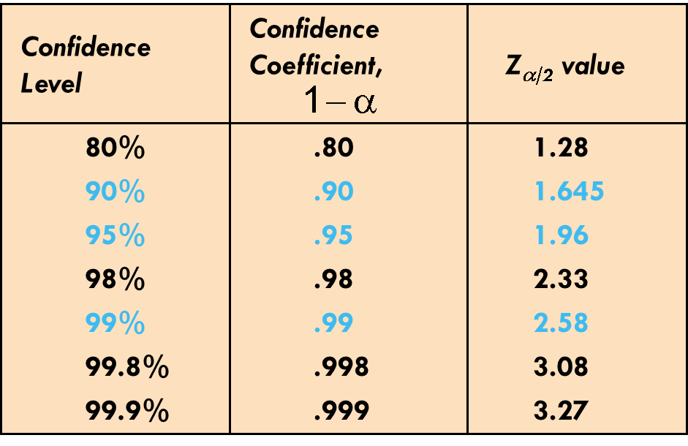
Common Levels of Confidence
Commonly used confidence levels are 90%, 95%, and 99%

Slide 77
Example
A sample of 11 adult inmates from a large population has a mean recidivism rate of 2.20 times. Assume we know from past surveys that the population standard deviation is 0.35.
Determine a 95% confidence interval for the true mean recidivism rate of the population.

Slide 78
A sample of 11 adult inmates from a large normal population has a mean recidivism rate of 2.20 times. Assume we know from past surveys that the population standard deviation is 0.35.
Solution:

Slide 79
Interpretation
We are 95% confident that the true mean recidivism rate is between 1.9932 and 2.4068 times per inmate.
More appropriately, although the true mean may or may not be in this interval, 95% of intervals formed in this manner will contain the true mean.

Slide 80
Confidence Interval for μ (σ² Unknown)
If the population standard deviation σ is unknown, we can substitute the sample standard deviation, s
This introduces extra uncertainty, since s is variable from sample to sample
So we use the t distribution instead of the normal distribution

Slide 81
Student’s t Distribution
The t is a family of distributions
The t value depends on degrees of freedom (d.f.)
Number of observations that are free to vary after sample mean has been calculated
d.f. = n - 1

Slide 82
Student’s t Distribution
Note: t Z as n increases
Standard Normal
(t with df = ∞)
t (df = 13)
t-distributions are bell-shaped and symmetric, but have ‘fatter’ tails than the normal
t (df = 5)
t
0

Slide 83
Student’s t Table
Upper Tail Area
Let: n = 3 df = n - 1 = 2 α = .10 α/2 =.05
df
.10
.05
.025
1
3.078
6.314
12.706
2
1.886
2.920
4.303
3
1.638
2.353
3.182
α/2 = .05
The body of the table contains t values, not probabilities
0
2.920
t

Slide 84
t distribution values
Confidence t t t Z
Level (10 d.f.) (20 d.f.) (30 d.f.) ____
.80 1.372 1.325 1.310 1.282
.90 1.812 1.725 1.697 1.645
.95 2.228 2.086 2.042 1.960
.99 3.169 2.845 2.750 2.576
Note: t Z as n increases

Slide 85
Example
A random sample of n = 25 has x = 50 and
s = 8. Form a 95% confidence interval for μ
d.f. = n – 1 = 24, so
The confidence interval is

